Slide 1
The Amazing NewBorn
PSY 226: Child and Adolescent Development

Slide 2
Learning Objectives
(1) Discuss the differences between pre-term, early-term, full-term pregnancy
(2) Know what the APGAR and NBAS are used for
(3) Describe several newborn risks
Prenatal and LBW
Postparten depression
SIDS
(4) List and describe the function of common newborn reflexes
(5) Describe the world of the newborn through its basic senses
Vision, Hearing, Taste, and Smell

Slide 3
Congratulations! It’s a Neonate!!!
Very Preterm = prior to 32 weeks
Preterm = prior to 37 weeks
Early term = 37-38 weeks
Full term = 39-40 weeks
Late term = 41+ weeks
12.5% in U.S.

Slide 4
Today 90% of “Premies” Survive but Remain At-Risk
RISKS
Low birth weight (under 5.5 pounds)
Respiratory Distress Syndrome
Lack of surfactin to carry O² in and CO² out of lungs
Vulnerability to Infection
Brain hemorrhages
Feeding difficulties
Vision, hearing, and motor impairments
Delayed walking
Difficulty moving and maintaining balance
Lower IQ and learning disabilities later
High quality preschool can help
PREDICTORS
Poverty
Malnutrition
Poor Prenatal Care
Smoking
Alcohol & Drugs

Slide 5
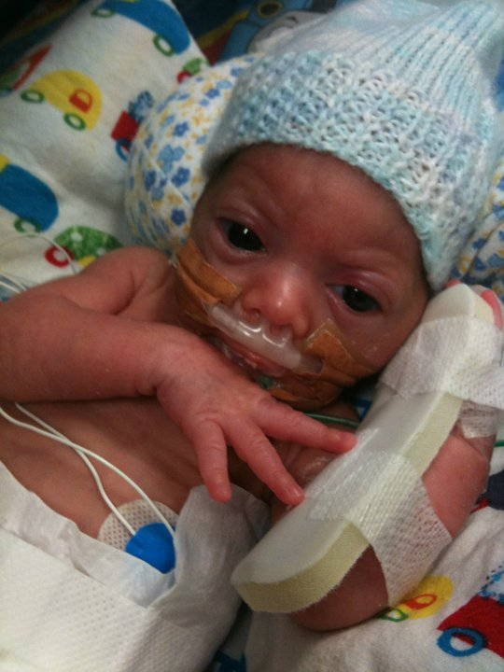
Premature Babies and Parenting: An Ironic Social Risk
Parenting demands are higher
But, premature babies often receive lower quality care (less sensitive and responsive)
Irregular sleep/wake cycles
Fussy or “difficult to soothe”
Less social
Appearance lacks “cuteness”

Slide 6
The myth of the first 9 months: Is a child worth waiting for?
https://www.youtube.com/watch?v=QN_ejTMJqZo
4:55

Slide 7
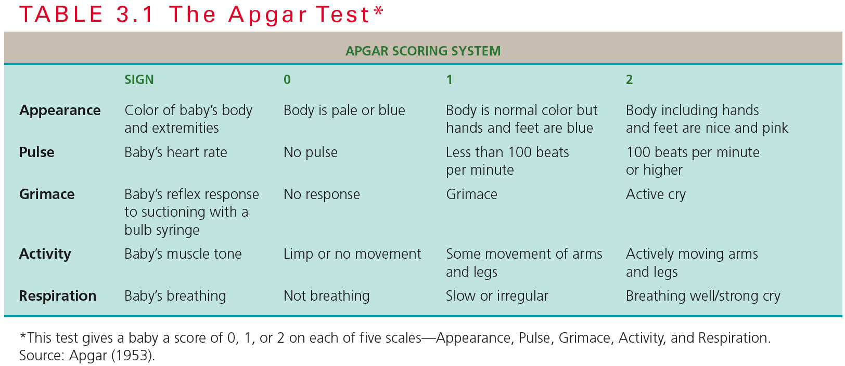
Newborn Assessments
1. APGAR
Screens for
overall health
at birth.
2. Neonatal Behavior Assessment Scale (NBAS)
Screens for behavioral and neurological problems.
28 behavioral and 18 reflexive measures.
Responses to light, sound, touch.
Track moving object.
Regulate states.

Slide 8
Maternal Depression
The “Baby Blues” refers to mild depression experienced the week following childbirth
Driven by hormonal changes
It is normal – most mothers experience the baby blues
Postpartem Depression (PPD) is a major depressive disorder
Onset about 1 month after childbirth
Symptoms are like major depression (sadness, hopelessness, loss of interest, etc.) and may also include episodes of elevated mood (like bipolar disorder)
Atypical, affecting 10-20% of mothers
Influenced by hormonal change (estrogen drop) but a history of prior depression is also a risk
Postpartem psychoses is a sub-type involving psychotic features (delusions and hallucinations)
http://www.cbsnews.com/news/depression-a-risk-during-pregnancy/

Slide 9
VIDEO: Preventing SIDS
2:30

Slide 10
Inborn Skills
The Competent Newborn
Reflexes are behaviors that require
no obvious post-natal experience.
Newborns have reflexes that increase the likelihood of survival.
The rooting reflex--when something touches a newborn’s cheek, the infant turns toward that side with an open mouth.
The sucking reflex can be triggered by a fingertip.
The palmar grasp reflex occurs when the infants palm is stroked.
Crying when hungry motivates parents to end the noise and feed the baby.
2:40
Notes:
Click to reveal bullets.
How do we conclude that these abilities are inborn?...because they are evident within hours of birth.
The rooting reflex triggers the baby to get in position for breastfeeding.

Slide 11
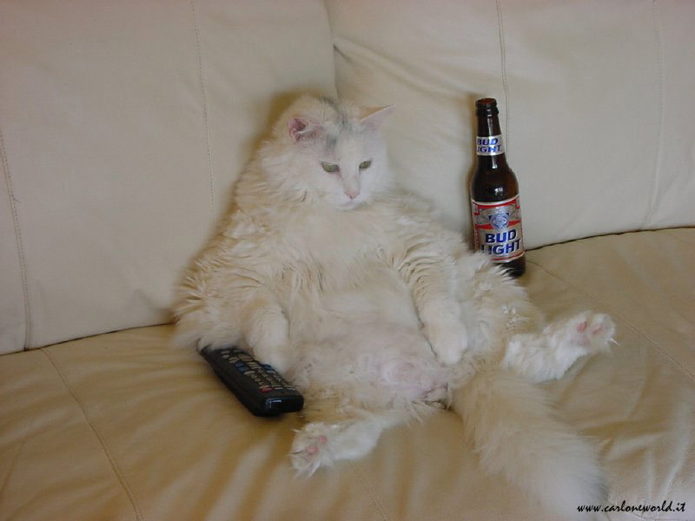
Evolution is a Lazy Concept
These reflexes disappear between 4-8 mo.
According William James, behavior is functional
Some have no clear purpose, so why do we have them?

Slide 12
The Confused Newborn?
“…on great blooming, buzzing confusion.”
-William James

Slide 13
True or False?
Newborns can see.
Newborns can see color.
Newborns taste like adults.
Newborns smell.

Slide 14
Newborns Can See
Neonates or near-sighted with about 20/600 vision and not very good acuity
Improves to adult-like vision over the first 6 months
Do not discriminate color well because the cones are developing
Improves rapidly over the first 4 months
They can and do track moving objects pretty well
BIRTH
6 MONTHS

Slide 15
Babies are not color blind, but…
Colors are “mushy” at birth
Cones are developing
2 mo. babies see colors well
4 mo. babies categorize the basic colors!
blue, green, yellow, red

Slide 16
Hearing is pretty sound
3 mo. PREnatal can respond to sound
Prefer frequencies around the human voice range
Distinguish high pitched sounds better than adults
“Motherese” speech is mutually reinforcing
Simple, higher tones, song like, exaggerated
20sec
30sec

Slide 17
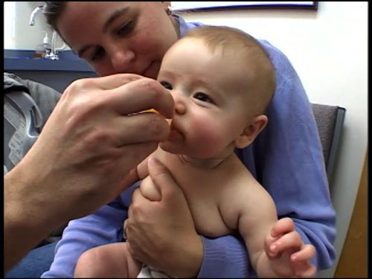
Newborns DO Taste Like Adults
Even preterm infants
prefer sweet tastes
Functional because breast
milk is slightly sweet
Dysfunctional in a world that
is now full of sweets!
45sec

Slide 18
Newborns DO Smell
If breastfed, 12-DAY-old infants recognize mom’s odor
Mom’s can also pick out
their babies smell in the first
days after birth
45sec

Slide 19
An Evolutionary Riddle – It’s So Easy A Baby Could Solve It
What is 7-9” away,
produces higher pitched sounds,
rhythmic tones,
moves and contains moving parts,
has contrasting areas,
has a pleasing taste and order?

Slide 20
Newborn Preference for Faces?

