Slide 1
Prenatal Brain development
PSY 226: Child and Adolescent Development

Slide 2
Common methods
(1) Post-mortem studies (static structures)
(2) Brain imaging studies (active functions)
(3) Animal studies (molecular and cellular development)
“Wiring” of neural architecture is neither fixed, nor static. It is a dynamic entitity that is shaped and reshaped throughout development by processes that have their own timetables.
-National Research Council and Institute of Medicine (2009)

Slide 3
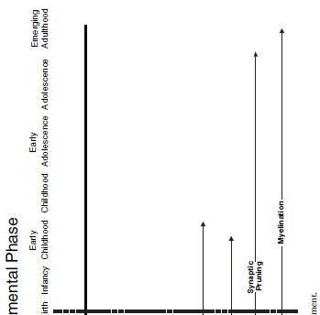
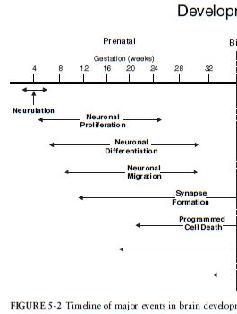
A timeline of events in brain development

Slide 4
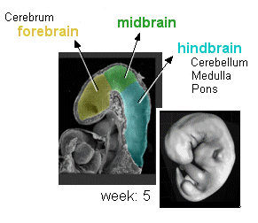
Setting up the nervous system
Neuralization – the process of neural system development.
Begins around 2-3 wks. after conception.
Starts as an undifferentiated layer of cells called the neural plate.
From front to back the neural plate becomes…
Forebrain (cerebral cortexes), the midbrain, the hindbrain (brain stem and cerebellum), and the spinal cord and nervous system.

Slide 5
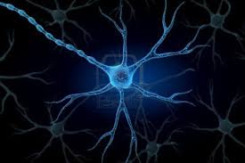
The right cells in the right place
Neurons start to form between 5-25 wks. Then what?
TWO PROCESSES
(1) Neural differentiation – every cell becomes progressively more restricted until they differentiate into a specific type of neuron.
(2) Neural migration – neurons travel from the site of their origin to their final origin in the brain to provide the function they will ultimately serve.

Slide 6
Neural Migration
Destination
The neurons path is determined by timing and position at origin.
Course
The “map” to destination is made up of molecular signals from neighboring cells that guide migration to its proper, final destination.
Travel times
Peak time for migration is around 20 wks. and it ends around 30 wks.

Slide 7
Disturbed neural migration
An accumulation of neurons in the wrong areas of the brain results in disorganized brain structure and with malfunction.
Seizures are gross forms malfunction
Impaired cognition (e.g., learning and memory)
Mental-Emotional-Behavior disorders

Slide 8
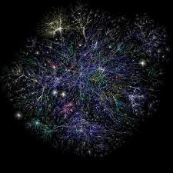
Establishing connections
Once “in place” neurons connect via axons and dendrites and communicate by passing neurotransmitter (“brain chemical) messages through the synapse.
Synapses rapidly increase 24-28 wks. prenatal.
40,000 synapses/second 3-15 mo. postnatal.
Some connections are proximal. Some are distal.
A diverse and complex communication network is formed across the brain.

Slide 9
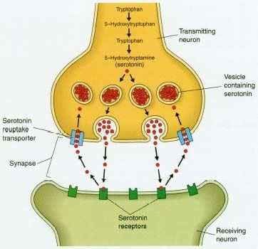
Synaptic miscommunication
Synaptic communication allows for learning, memory, and emotions to occur.
Faulty communication at the synapse (e.g., too much or too little neurotransmitter) appears to be involved in may mental, emotional, and behavioral disorders.
E.g., cognitive disabilities, depression, autism, etc.

Slide 10
Use it or lose it
Programmed Cell Death (Apoptosis). To survive, neurons must connect with a target cell or they will die.
Synaptic Pruning. There is an initial surplus of neural connections. Those that are not use – do not connect and communicate – are eliminated.

Slide 11
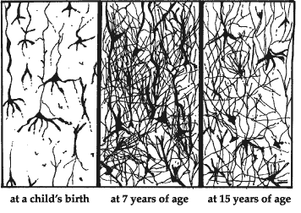
Synaptic pruning
The brain becomes more efficient by retaining only what it uses. What gets used depends on the thinking involved in adapting to our environment.
Synaptic formation and pruning goes on through childhood.
There is huge resurgence of pruning in adolescence and over 40% of synapses are eliminated. (so the brains efficiency increases a lot!)
Pathologic pruning also underlies some MEBs
E.g., Schizophrenia includes symptoms such as hallucinations that may involve a failure to eliminate unused connections, or the elimination of those that are being used.

Slide 12
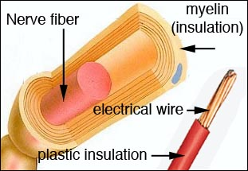
myelination
Myelin is the fatty, whitish sheath that forms around axons and acts like insulation to promote more rapid and efficient electrical impulses (improves communication).
Becomes rapid 1-2 mo. prior to birth through the 2nd year of life.
Continues through adolescence and into adulthood.
Deficient myelin production may be involved in mental illnesses involving social withdrawal (e.g., depression, anxiety, schizophrenia, and autism).
Severe social isolation may impair myelination.

