Slide 1
Out-of-School Time as an Opportunity for Reducing Risks and Promoting Competence
PSY 372
Developmental Psychology and Social Intervention

Slide 2
Learning Objectives
(1) Understand the circumstances under which self-care is, and is not, a risk for social and academic problems.
(2) Understand the conditions under which organized after-school activities can reduce risks related to self-care and promote developmental competencies.

Slide 3
Part I: Self-Care
Should we Care about Young People
Who Care for Themselves?

Slide 4
Myths and Facts about Self Care
1. In general, self care is most common for:
a) Children of middle-class, educated, suburbanite parents
b) Disadvantaged children living in the inner-city
c) Children of unemployed parents
d) African-American and Latino children

Slide 5
Myths and Facts about Self Care
1. In general, self care is most common for:
a) Children of middle-class, educated, suburbanite parents
b) Disadvantaged children living in the inner-city
c) Children of unemployed parents
d) African-American and Latino children

Slide 6
Rates of Self Care* Ages 5-14: by Poverty Status (2013)
Source: U.S. Census Bureau (2013)
http://www.census.gov/library/publications/2013/demo/p70-135.html
*”Pure” self care (not sibling care)
*Primary arrangement (most hrs./week)

Slide 7
Rates of Self Care Ages 5-14: Race/Ethnicity (2013)
%
Source: U.S. Census Bureau (2013)
http://www.census.gov/library/publications/2013/demo/p70-135.html

Slide 8
Myths and Facts about Self Care
2. As children age and transition to adolescence, self care:
a) Increases
b) Decreases
c) Stays the same

Slide 9
Myths and Facts about Self Care
2. As children age and transition to adolescence, self care:
a) Increases
b) Decreases
c) Stays the same

Slide 10
Rates of Self Care: Age and Maternal Employment (2013)
%
AGE
Source: U.S. Census Bureau (2013)
http://www.census.gov/library/publications/2013/demo/p70-135.html

Slide 11
What % of Kids in the USA are in Self Care and After-school Program Care: America After 3pm Survey (2014)
USA
Self Care: 26% K-12 (11.3 million)
7.3 hours/week
ASPs = 15% K-12 (10.2 million)
41% of those not in afterschool program would be if available
19.4 million unmet demand
PA
Self Care = 24% K-12
ASPs = 17% K-12
50% of those not in afterschool program would be if available
http://www.afterschoolalliance.org/AA3PM/

Slide 12
Self Care and ASPs by Age
RED = SELF CARE GREEN = ASPS
%
GRADE
http://www.afterschoolalliance.org/documents/AA%203%20pm_Executive_Summary.pdf

Slide 13
Myths and Facts about Self Care
3. Research on the consequences of self care shows that it depends on:
a) The type of child considered
b) Parenting style and monitoring
c) Where the children live
d) The presence of peers
e) Gender

Slide 14
Myths and Facts about Self Care
3. Research on the consequences of self care shows that it depends on:
a) The type of child considered
b) Parenting style and monitoring
c) Where the children live
d) The presence of peers
e) Gender

Slide 15
Parenting Style and Monitoring
“Whether you like or dislike your father, it will be more convenient to smoke marijuana when he isn’t there.”
Does not mean that parenting is unimportant
Parental knowledge is important
Control, Solicitation and ….
Communication

Slide 16
Parenting Style and Monitoring
Basic Parenting Styles
Authoritarian
Permissive
Authoritative
Neglectful
Key features: Warmth/Support, Control

Slide 17
HIGH
PERMISSIVE
AUTHORITATIVE
control
LOW
HIGH
support
UNINVOLVED/
NEGLECTFUL
AUTHORITARIAN
LOW

Slide 18
Parenting Style and Monitoring
Basic Parenting Styles
Authoritarian, Permissive, Authoritative, Neglectful
Key features: Warmth/Support, Control
Authoritative parenting reduces the risk of unsupervised peer socialization (Steinberg)
More communication, fewer secrets, more trust
More effective monitors in absentia
Rules for checking in
Communication by phone
Parental networks

Slide 19
Myths and Facts about Self Care
3. Research on the consequences of self care shows that it depends on:
a) The type of child considered
b) Parenting style and monitoring
c) Where the children live
d) The presence of peers
e) Gender

Slide 20
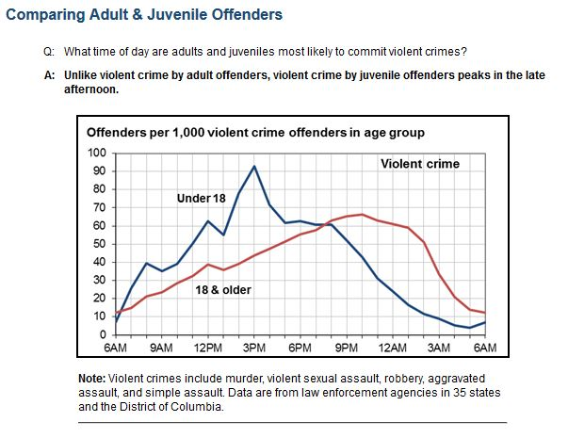
Simple Assumptions: After-school Time and Delinquency: Peak Hours for Juvenile Violence (2014)
Internet citation: OJJDP Statistical Briefing Book. Online. Available:
http://www.ojjdp.gov/ojstatbb/offenders/qa03401.asp?qaDate=2010. Released on May 22, 2014.
Notes:
Likewise the Washington-based group Fight Crime, Invest in Kids has made use of the fact that the peak hours for serious juvenile violence occurs during the hours following school dismissal.
An extrapolation of this fact would be that youth in after-school programs and activities would not be committing these violent acts.
However, there is some danger in the extrapolation. Specifically, the mere provision of these programs does not ensure that they will be beneficial.
Moreover, when they are beneficial, the association is often complex.

Slide 21
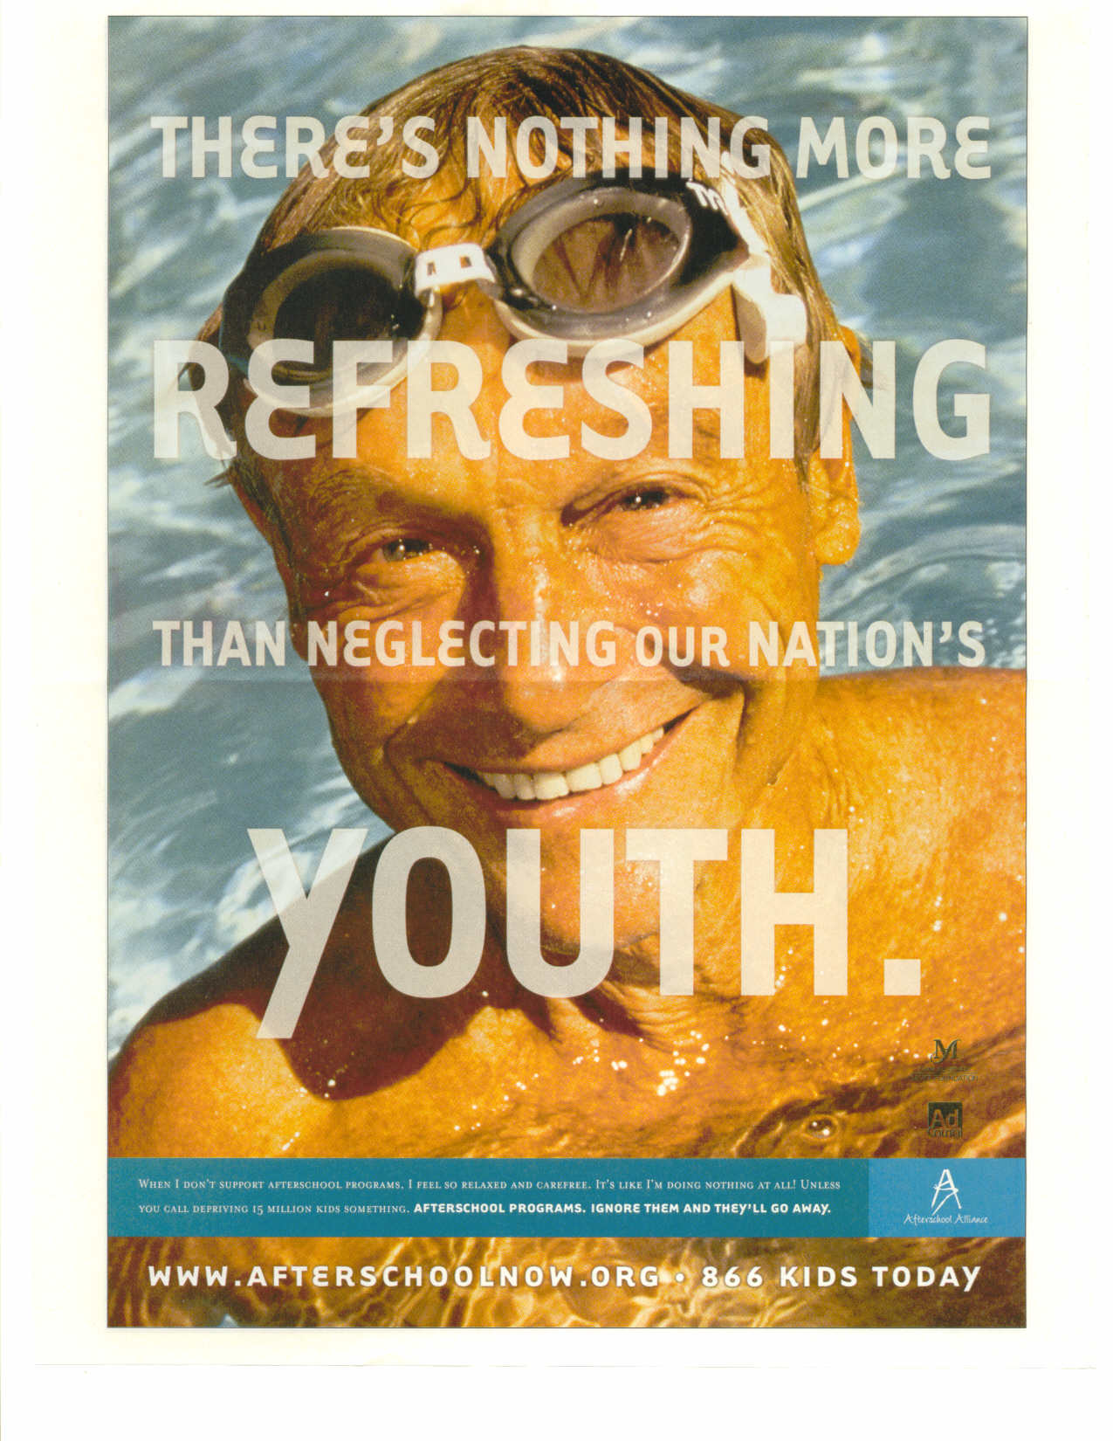
Simple Assumptions
“There’s nothing more
Refreshing
Than neglecting our nation’s
Youth.”
“When I don’t support after-school
programs, I feel so relaxed and
carefree. It’s like I’m doing nothing
at all! Unless you call depriving
15 million kids something.”
Afterschool programs.
Ignore them and they’ll go away.
Source: Time (September 2004). Advertisement sponsored by the Afterschool Alliance
Notes:
This advertisement…. Not Viagra… After-school Alliance
The figure – 15 million kids – refers to Nationally representative household survey of 30,000 families with children grades K-12 in U.S. who often experience self care
Extrapolation…
Self care grades 1-5 = 1.3 million
Self care grades 6-8 = 3.9 million
Self care grades 9-12 = 9.8 million

Slide 22
Routine Activity Theory
Self care, per se, is not a risk
Situational motivation is key
Some situations motivate deviance more than others

Slide 23
Motivating Situations
Risk depends on context:
(1) Level of structure and agenda
No plan for how the spend the leisure time
“Hanging out”
(2) Presence of peers
Most deviance is group based
Peers: reward, resources, reduce
(3) Degree of supervision and monitoring
Adults obligated to intervene in structured settings
No adults, away from home is worst

Slide 24
Parents Limits on Unsupervised Socializing
Peer Interactions are increasingly
Unsupervised and out-of-home
More
than
12 hours
30 min
or less
AGE
Young Adults: accounts 27-48% of
of age-related increases in
Antisocial behaviors
Source: Osgood et al. 2005

Slide 25
Peers Matter Too
Osgood et al. suggest that unsupervised peer socialization can be a risk whether or not the peers are deviant
Long literature showing the affiliating with deviant peers augments the development of antisocial behaviors
Cambridge-Somerville Youth Study (Joan McCord)
1939-1944
Experiment for High Risk Boys: Mentors, Camps, Outings
Treatment group: At young adulthood, more psychological disorders, addictions, and higher rates of death!

Slide 26
Neighborhood Conditions Matter
Studies (e.g., Levine Coley et al., 2004; Pettit et al., 2007) show that out-of-home self care occurring in disadvantaged and high crime neighborhoods is most likely to predict increases in problem behaviors.
What should we do?
Ask them to move?
Target ASPs in those areas

Slide 27
Myths and Facts about Self Care
4. Compared to self care during childhood, adolescents who care for themselves are:
a) At greater risk for psychosocial and educational problems
b) At lesser risk for psychosocial and educational problems
c) At risk for different types of psychosocial and educational problems
d) More likely to benefit from the experience

Slide 28
Myths and Facts about Self Care
4. Compared to self care during childhood, adolescents who care for themselves are:
a) At greater risk for psychosocial and educational problems
b) At lesser risk for psychosocial and educational problems
c) At risk for different types of psychosocial and educational problems
d) More likely to benefit from the experience

Slide 29
Children are at-risk for more than boredom
http://www.afterschoolalliance.org/documents/media/psaYouthBlowFish%2030.wmv
http://www.afterschoolalliance.org/documents/media/psaYouthSockFriend.wmv
Although more likely to be in-home, risks include:
Fear and anxiety (Long & Long, 1972)
Accidents and injuries
Unhealthy eating
Use of tobacco
Abuse (Congressional Children’s Caucus, 1983)

Slide 30
Myths and Facts about Self Care
5. From a bioecological perspective, understanding the risks of self care depends on:
a) The child’s other after-school microsystems
b) The configuration of the sun, moon, and stars relative to Jupiter
c) The time and timing of the self care experience
d) The balance of humidity, temperature, and water in the self care terrarium.

Slide 31
Myths and Facts about Self Care
5. From a bioecological perspective, understanding the risks of self care depends on:
a) The child’s other after-school microsystems
b) The configuration of the sun, moon, and stars relative to Jupiter
c) The time and timing of the self care experience
d) The balance of humidity, temperature, and water in the self care terrarium.

Slide 32
Chronosystem: Time & Timing
In general, behavior problems are more likely for youth who spend several hours/week in self care
Adolescent smoking (Mott et al., 1999)
Externalizing behavior problems (Pettit et al., 1999)
Substance use and depression (Richardson et al., 1989; 1993).
Outcomes may be amplified when it begins in childhood and continues through adolescence

