Slide 1
Family-Based Interventions
PSY 372: Developmental psychology and social intervention

Slide 2
Learning Objectives
Identify “windows of intervention” for promoting healthy parenting and child development
Describe the “Teen Outreach” intervention and its impact
Discuss the different approaches (Erickson and Van den boom) to promoting secure infant-caregiver attachment
Theoretical/conceptual bases
Intervention designs
Outcomes and conclusions
Indicate the prevalence of, and risks for, child maltreatment
Discuss the nurse-home partnership intervention and research (Olds) on its impacts and cost effectiveness

Slide 3
The Family as a Focus of Social Intervention
Families are the primary socialization agent of young people and parents may have positive or negative on children’s development depending on the competencies of the caregiver.
There is a lot of room for parents to have negative influence:
Parenting is likely the most important responsibility a person can have. But, there are no qualifications or requirements for the position. Moreover, one often has to be overtly terrible – often many times over – to lose this responsibility for some amount of time.
Society views the average parent as “good enough” and/or that it is ordinarily nobody’s business how parents raise their children.

Slide 4
Early Parenting Intervention Windows
Prior to Pregnancy
Teen Outreach Program
Prenatal development and Infancy
Attachment-Focus Interventions
Nurse Home Visitation Programs
Early Childhood
Parenting practices and skills

Slide 5
Preventing Early Childbearing
US has the highest rate of teen pregnancy in the industrialized world
800-900k pregnancies each year
Rate for African-Americans highest, followed by Hispanics, and Whites
Tied to SES
45% aborted/miscarriage (no live birth), 50% child is raised by single teen mom, 5% adopted

Slide 6
Preventing Early Childbearing
Evidence that teen moms are less ready to parent
See their kids as especially difficult to raise
Spend less time interacting with them
Inappropriate developmental expectations
Less effective interactions
Problematic outcomes for children
Children of teen moms are more apt to develop school/academic problems, behavior misconduct, and engage in early sexual activity
Problematic outcomes for teen moms
Limits imposed on education and career options
School dropout, especially if teen mom twice

Slide 7
Teen Outreach Program
National Volunteer Service Program
Avg. 50 hours volunteer community service
Weekly discussions, group work, role plays, guest speakers about the volunteer work or the important developmental tasks they faced that were of interest and relevance to the participants
25 national sites participated. Over-subscription allowed for a randomized design using a wait-list comparison group.
Students could take the program in school in lieu of a required Health or Social Studies class
N = 342 T.O., N = 353 W.L., Gds. 9-12, 86% Female, 67% African American, 17% White, mostly low-income, single parent families
Self-report questionnaire at the beginning and end of the academic year
Student reports were very similar to school records of suspensions and course failures
Allen et al. 1997. Child Development.

Slide 8
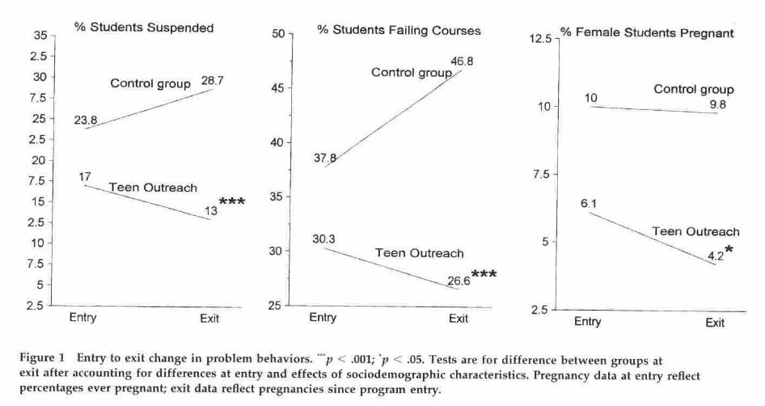
Teen Outreach Program: Results
OR = .41 to 1.0
OR = .39 to 1.0
OR = .42 to 1.0
Allen et al. 1997. Child Development.

Slide 9
Attachment as an Intervention Target
Importance is supported by a considerable literature
High risk groups have been identified
Some causal antecedents are implicated
Child Temperament
Life stressors
Parenting

Slide 10
Attachment
“The quality of relationship between the infant and caregiver(s) that occurs during the 2nd half of the first year of life. It is not a property of the infant OR the caregiver, but a product of their relationship – a style of interacting – it is a term that describes the pattern of interaction and is presumed to have important developmental consequences.” (A. Sroufe)

Slide 11
Determinants of Attachment Quality
Sensitivity vs. Insensitivity
Cooperation vs. Interference
Reading the child’s signals correctly
Responding appropriately and consistently
Guiding, rather than controlling the child

Slide 12
Determinants of Attachment Quality
Sensitive/Cooperative: “cooperating with their infants. They were guiding rather than controlling their babies activities. They integrated their wishes, moods, and household responsibilities with their babies’ wishes and on-going activities. The interactions seemed co-determined.” (Egeland et al., 1992).

Slide 13
Determinants of Attachment Quality
Insensitive: Responses are geared almost exclusively to the caregivers own wishes, moods, and activity. If the responses mesh with child’s signals or needs, this is often no more than coincidence.
(adapted from E. Waters)

Slide 14
Attachment Categories
Secure Attachment Relationship (65%)
1. Caregiver is a secure base for exploration
2. Active in seeking contact or interaction upon reunion
Insecure Ambivalent/Resistant Attachment Relationship (15%)
Poverty of Exploration
2. Difficulty settling upon reunion
Insecure Avoidant Attachment Relationship (20%)
Independent Exploration
2. Active avoidance upon reunion

Slide 15
Two Approaches to Intervention
Erickson et al. (1992) and Van den boom (1995)
Similar Goals - To improve the quality of the relationship between mother and child to prevent social behavior problems associated with an insecure attachment relationship.
Different Findings
Interventions can help us test developmental theories and sort out controversies

Slide 16
Internal Working Model
“The implication is that the way the infant organizes his or her behavior toward the mother affects the way in which he or she organizes behavior toward other aspects of the environment both animate and inanimate. This organization provides a core of continuity in development despite changes that come with developmental acquisitions, both cognitive and socioemotional.” (Ainsworth, 1979; p. 936)

Slide 17
Internal Working Model
Caregiver Sensitivity and Responsiveness are the Basis for a Child’s Internal Working Model
>Expectations of caregiver and his/her responsiveness
>Beliefs about the self and deservingness of such care
Sense of what others are like and how they respond to me
Whether I can depend on others
Whether I am worthy of others attention and love

Slide 18
Steep: Assumptions
“To change a maladaptive attachment relationship between parent and child, one must ultimately change the internal working model of the relationship for both parent and child.” (Erickson et al., 1992; p. 499).

Slide 19
Project STEEP
“To change a maladaptive attachment relationship between parent and child, one must ultimately
change the internal working model of the relationship for both parent and child.” (p. 499).
“Understanding”
Their Babies
Parenting Behavior
Sensitive/Responsive
Attachment
Quality
Mother’s
Mental Health
Mothers
Internal
Working
Model
Child
Internal
Working
Model

Slide 20
STEEP: Assumptions
Changing the parents working model will change parenting behavior
A long-term, therapeutic relationship is required
Parents “insight” into how early childhood experiences affect their own parenting must come into awareness
Transference through the relationship (disclosure, trust, intimacy)

Slide 21
STEEP: Intervention
154 first-time mothers; poverty; low education; social isolation; stressful life circumstances
RCT: Treatment or control group
18 mo. of home visits (from 2nd TM)
Bi-weekly group sessions for 1 year
Education, social, mutual support

Slide 22
STEEP: Outcomes
Parent reports: fewer depression symptoms, less anxiety, better life management skills
Raters: better knowledge of child’s needs, more stimulating environment
NO CHANGE noted for: parenting behaviors, IWM, attachment quality, child behaviors

Slide 23
Dutch Study: Key Differences
Approach: Behavioral vs. Therapeutic
Intensity: Intervention involves only 3, 2-hour sessions of specific skills training
Responding to infant cues
Change the behaviors directly
Timing: Intervention occurs between 6-9 months

Slide 24
Dutch Irritable Infants
“…behaviorally oriented, short-term preventive interventions…are more effective
in changing parental insensitivity and children’s attachment insecurity than
longer, more intensive, and therapeutic approaches.” (p. 1798).
Intrusiveness &
Detachment
Family
Relationships
Child
Temperament
Attachment
Quality
Peer
Relationships
Attachment
Quality
Child
Behavior
Sensitive
Responsive
Fathering

Slide 25
Promising Design Features
Multiple Follow-ups to 42 months
Behavior assessed in different settings (mother-child, family, peers, free play, etc.) and sources (parent report, home and lab observational ratings, early childcare setting)
Test of whether change in attachment quality drives changes in parenting and peer relations
Spread of effect (concordance of parenting behaviors between mothers and fathers)

Slide 26
David Olds’s Home Visitation Intervention

Slide 27
Learning Objectives
Identify “windows of intervention” for promoting healthy parenting and child development
Describe the “Teen Outreach” intervention and its impact
Discuss the different approaches (Erickson and Van den boom) to promoting secure infant-caregiver attachment
Theoretical/conceptual bases
Intervention designs
Outcomes and conclusions
Indicate the prevalence of, and risks for, child maltreatment
Discuss the nurse-home partnership intervention and research (Olds) on its impacts and cost effectiveness

