Slide 1
Methodology
PSY 372: Developmental Psychology & Social intervention

Slide 2
Learning Objectives
Indicate what strong methods allows us to do and provide examples of the dangers of not employing them to evaluate social interventions.
Be able to describe the two main types of intervention trials and what they are used for.
Be able to discuss RCTs, variants to traditional RCTs, and limitations of RCTs?
Discuss common challenges to RCTS including contamination and cross-over of condition.
Be able to discuss intent-to-treat analysis and some challenges associated with it.

Slide 3
Strong Methods Allow Us to Answer…
Whether an intervention works as intended, for whom, which components, under what conditions, and for how long.

Slide 4
Where do we Start?
We often begin with an interest in one or more outcomes
We consult or conduct basic research on developmental antecedents and pathways
Risk, Protective, and Promotive Factors
We develop a theory of change
Logic models
Is the theory supported by existing research?

Slide 5
Two Types of Trials
Efficacy trial – study the impact of an intervention under ideal conditions.
Answers the question, “Can the intervention work?
Usually smaller scale “pilot studies”
Often funded by the research team.
Components are often delivered by the research team.
Effectiveness trial – study the impact of an intervention under conditions that are likely to occur in the “real world.”
Answers the question, “Does this work in the real world?”
Usually requires a research-community collaboration.

Slide 6
Both Trials May Be RCTs
An RCT (Randomized Controlled Trial) is an experimental study
Participants are randomly assigned to the intervention (treatment) and one or more comparison groups (control)
Comparison group may also receive a “treatment.”
Compare different treatments
Compare different components
Compare different doses

Slide 7
Variations of RCTs
Waitlist designs
The group assigned to the waitlist receives the intervention later.
May help with ethical concerns about withholding treatment.
Cutoff designs
Age-based cutoffs
For kindergarten, children must reach the compulsory school age of five on or before September 1.
Due date cutoffs
Enrollment applications for childcare are accepted until September 1 on first come, first served basis.

Slide 8
Challenges to RCTs
Assigning people to a treatment does not mean they will receive it.
Fidelity – delivery of the intervention as it was intended.
The intervention is not delivered as it should have been.
Participants may not fully comply with the treatment as prescribed.
Participants may lose interest or drop out anytime after being assigned to the treatment (attrition).
Encouragement designs may be embedded in the research.

Slide 9
Challenges to RCTs
Assigning people to a comparison group does not always mean they will stay in it.
The control group always gets something.
Humans are not rats in a lab. Children, youth, and families in intervention research are often aware of their research condition.
Parents are usually motivated to do everything they can for their children.
Being assigned out of treatment can motivate people to find their own treatment that may be as good or better than their intervention.

Slide 10
“Contamination” or Cross-Over of Condition
The treatment group does not get the treatment, so their experience during the intervention may be like the comparison group.
The comparison group gets the treatment or something like it, so their experience during the intervention may be like the treatment group.
What can we do? How shall we analyze the data?

Slide 11
Intent-to-Treat (ITT): “Once randomized, always analyzed”
Randomized clinical trials analyzed by the intention-to-treat (ITT) approach provide unbiased comparisons among the treatment groups. Intention to treat analyses are done to avoid the effects of crossover and dropout, which may break the random assignment to the treatment groups in a study.
We assess the outcomes according to the intention to treat all persons in the treatment group and not to treat those in the control or comparison group.
Pros: ITT analysis maintains prognostic balance generated from the original random treatment allocation.
Cons: It ignores noncompliance, protocol deviations, withdrawal, and anything that happens after randomization.
http://www.ncbi.nlm.nih.gov/pmc/articles/PMC3159210/

Slide 12
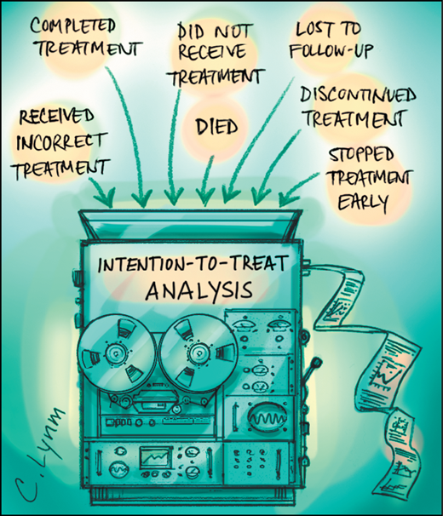
What differentiates the groups?
RCT only ensures the possibility of
Equivalent groups at the outset.
If they differ for any reason that may impact the outcome,
The results of the study are in question.

Slide 13
Who is likely to be non-adherent?
Those at the highest risk for the disorder
may also be the most difficult to recruit
and retain in intervention research.

Slide 14
Alternatives to ITT analysis: These “break” the random assignment
(1) Only compare “pure” cases. For example, those who received the full treatment as intended vs. those who received no known, comparable treatment.
(2) Assess dosage. Systematically compare those that received differing amounts of the treatment to those who received no known, comparable treatment.

Slide 15
Homework
Other uses for random assignment in intervention research….
Read pp. 273-274
For each of the six uses, develop an example to share with the class.

Slide 16
Other Limitations of RCTs
Community / Participant Concerns
(1) Distrust of researchers
https://www.youtube.com/watch?v=g6LY3zNQyFE
(2) Belief that RCT (random chance) is not fair
(3) Intervention does not match with community values
(4) Fear of being “treated” or viewed as in need of help (stigma)
(5) Not wanting to show cause and effect

Slide 17
Other Limits of RCTs
RCT at the individual level is often not possible
When assignment is at an aggregate level (class, school, neighborhood) very large samples are needed
Self-selection
Those who would be randomized assigned may be unrepresentative of the population
Long-term outcomes take a long time to happen
Short-term findings may be misleading
If it’s a multi-component intervention, RCT won’t necessarily tell you what worked

Slide 18
Learning Objectives
Indicate what strong methods allows us to do and provide examples of the dangers of not employing them to evaluate social interventions.
Be able to describe the two main types of intervention trials and what they are used for.
Be able to discuss RCTs, variants to traditional RCTs, and limitations of RCTs?
Discuss common challenges to RCTS including contamination and cross-over of condition.
Be able to discuss intent-to-treat analysis and some challenges associated with it.

