Slide 1
The role of screening in prevention
PSY 372
Developmental Psychology and Social Intervention

Slide 2
Learning objectives
1. Understand population/community and indicated screening
2. Discuss pros and cons to screening
3. Be able to describe and give examples of 5 guiding criteria for when to screen

Slide 3
THREE parts
(1) Identify relevant risk factors
(2) Identify those at risk (screening, assessment)
(3) Deliver an intervention to address the risks

Slide 4
Levels of screening
Population/Community and Group-Level Prevention Screening
Screen for general risk exposure across many people
Risks are often contextual (i.e., family, school, neighborhood)
E.g., Screen for maternal depression during a pediatric visit
Other examples of risks: poverty, violence, lack of health care, divorce, suicide of classmate

Slide 5
Levels of screening
Indicated Prevention Screening
Screen individual characteristics that place one at risk
E.g., Which children have shown a sudden drop in grades?
Other examples: particular clinical symptoms (e.g., difficulty staying in seat), behavior problems (e.g., getting into fights), or biological/genetic risks (e.g., improper nutrition)

Slide 6
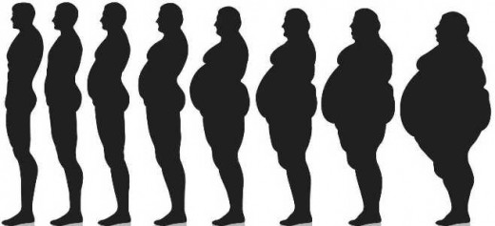
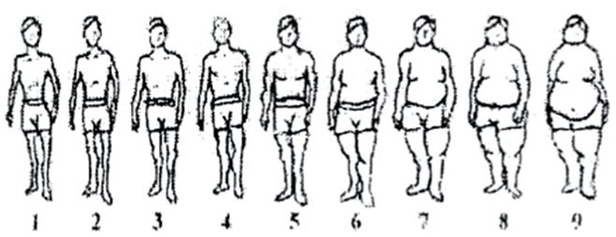

Slide 7
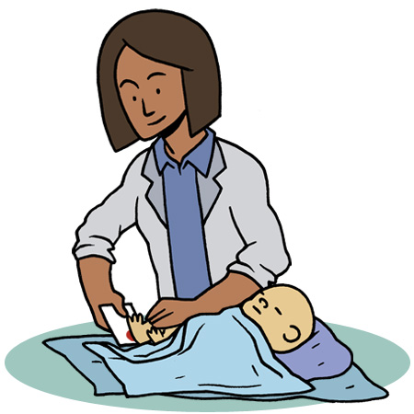
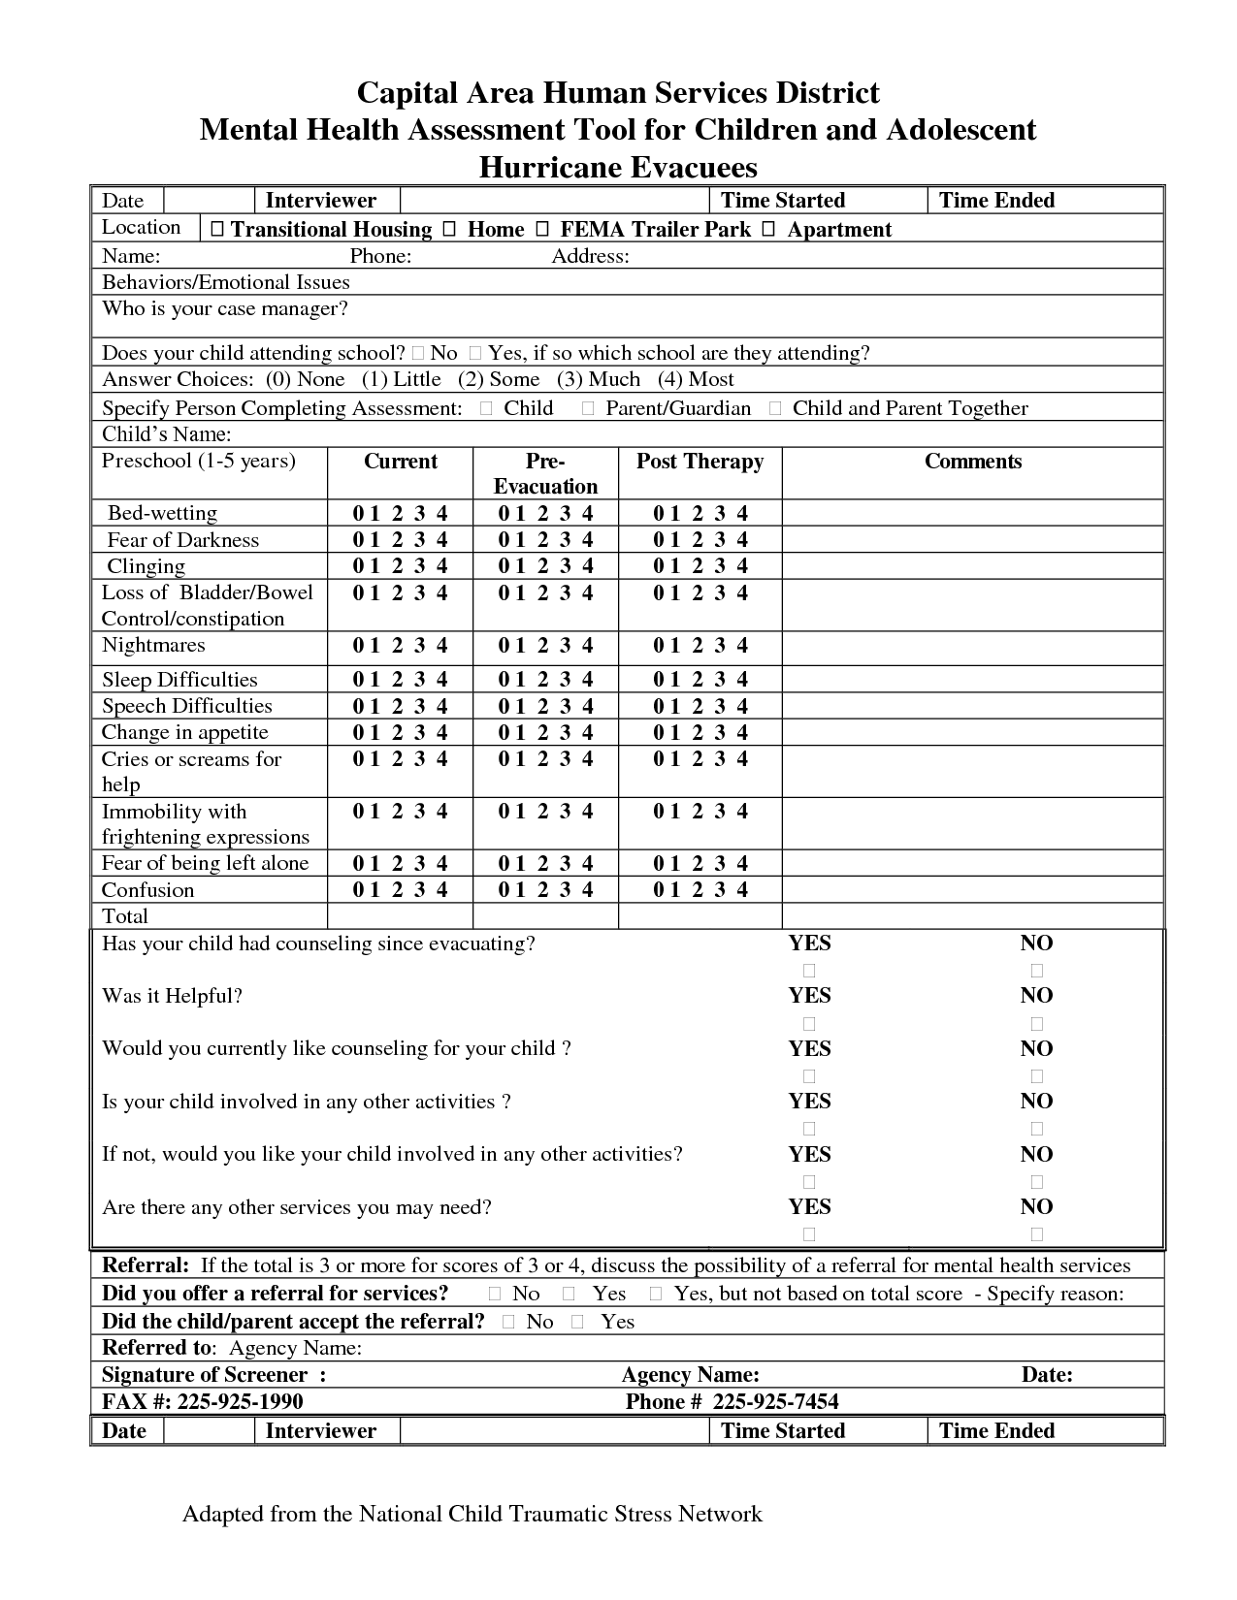
Is this common?
As a society we are okay screening every newborn for health risks (e.g., the APGAR test) and letting the state pay for it. But, we are not okay with screening children of any age for MEBs.
Do you remember any mental health screenings?
Does E-town do any of this? Do you think it should?
Some issues:
Costs (you are temporary)
Beyond the mission
of higher education
Student/parent concern
What would a college do
with the results?

Slide 8
When to screen?: guiding criteria
(1) The risk should be serious.
We can screen for everything.
What is serious may depend.
Age, Gender, Cultural Background
Let’s screen for
Anxiety and Depression
at College.

Slide 9
When to screen?: guiding criteria
(2) There are known, identifiable risk factors that precede the disorder.
Causally related to outcomes.
It is ideal if the timing of risk to outcome is understood even if the origin of the risk is unknown.
Loss of appetite
Weight gain
Body Satisfaction
Sleep problems
Alone/Loneliness
Sadness

Slide 10
When to screen?: guiding criteria
(3) We have an effective intervention for the risk.
The risks are modifiable.
The intervention has been effective on the population identified to be at risk.
Non-Modifiable Risks
Gender
First-time College Student
Class

Slide 11
When to screen?: guiding criteria
(4) We have acceptable and validated screening tools
Sensitive measures that do not cause (unnecessary labeling)
High false-positive → Stigma
High false-negative → Miss those in need
Need to be culturally relevant
Examples:
BECK
ITSEA and BITSEA

Slide 12
When to screen?: guiding criteria
Primary Care Screening
Parental concern is an important indicator.
Physicians are seldom trained to in prevention screening for MEBs.
Existing care facilities are not always connected to follow-up services needed.
Psychiatry, clinical psychology, social work
Behavioral health screening (mental wellness) is often not covered by insurance.
ITSEA and BITSEA

Slide 13
When to screen?: guiding criteria
Preschool and Day Care Screening
Identify children at-risk for a lack of school readiness
Preschool Childhood
Irregular eating → Behavior problems (family conflict)
Chronic illness → Depressive symptoms (maltreatment)
Head Start already has mandatory mental health screening for all participants
Challenges: Cost, Staff Training, Follow-up Services

Slide 14
When to screen?: guiding criteria
School-Based Screening
IDEA provides funds for screening
Voices of opposition (students, teachers, parents, administrators)
(1) How will the results be used?
Stigma, labeling
What do with the kids that are identified?
Is the purpose for the screening clearly specified (e.g., reduce bullying)
(2) It is extra work to screen and report
(3) Who should be the informant(s)

Slide 15
When to screen?: guiding criteria
(5) The screening process should be affordable
$4-7/month for preschool pediatric screening
(6) Screening is done regularly and tracked longitudinally
Risks change

Slide 16
Learning objectives
1. Understand population/community and indicated screening
2. Discuss pros and cons to screening
3. Be able to describe and give examples of 5 guiding criteria for when to screen

