Slide 1
Developmental Science
PSY 372 Developmental Psychology and Social Intervention

Slide 2
Learning objectives
Be able to describe how age, time, and timing are relevant for prevention.
Know the elements of the bioecological model and give examples of its utility for social intervention.
Define and differentiate: competence, developmental cascades, patterning of risks.
Define and discuss risk and projective factors and how they operate over time.
Provide examples of how scientific knowledge of risk factors for common MEBs would translate into intervention approaches.
Discuss examples of “generic risk factors” for MEBs.

Slide 3
Creating a framework
The basic goal of social intervention
Modify developmental processes and change pathways/trajectories away from disorder and/or towards health and wellness.

Slide 4
Creating a framework
AGE will affect when disorders are present (and what they mean)
Median age of onset:
Anxiety disorders = 11 years
Substance use disorders = 20 years
Mood disorders = 30 years
Time, Timing, and “The Prevention Window”
Symptoms for most disorders emerge early
Diagnosable symptoms often occur 2-4 years before the full disorder
The Window of
Opportunity Won’t
Open Itself

Slide 5
Creating a framework
Multiple Contexts are likely to be involved in the emergence and maintenance of most MEBs
The BioEcological Framework
Urie Bronfenbrenner

Slide 6
Bronfenbrenner’s Bio-Ecological Model of Human Development

Slide 7
Microsystem
Level most immediate
to the developing
Individual
Direct/Proximal Experiences
Within a Setting
Face-to-face contact
E.g., home, school, peer

Slide 8
Mesosystem
Interrelations among two
or more Microsystems
E.g., home-school
home-church
school-neighborhood

Slide 9
Exosystem
Collection of settings
that indirectly affect
child development
E.g., parents work
school board
parent’s peers

Slide 10
Macrosystem
Beliefs, ideologies,
and laws that
organize a society
E.g., religion, culture

Slide 11
Chronosystem
Time and Timing
Historical and
Developmental time
Timing
of life events
E.g., parenthood
puberty
marriage
Time

Slide 12
Affirm your understanding
Form small groups at the tables.
Evaluate the following case through the lens of the bioecological model. Identify as many risks and the levels to which they belong?
Using the concentric circle diagram, describe your examples to the class.

Slide 13
RISK AND PROTECTIVE FACTORS
RISK FACTORS: A characteristic at the biological, psychological, family, community, or cultural level that precedes and is associated with a higher likelihood of problem outcomes.
Causal Risk Factors. Modifying the factor would cause a change in the outcome.
Risk Markers. Can appear identical to causal factors, but changing a marker will not cause the outcome to change. Therefore, modifying risk markers will not prevent disorders.
Examples?
How do you tell the difference?

Slide 14
Project competence: Developmental cascades
CHILDHOOD ADOLESCENCE YOUNG ADULT
academic academic Internalizing
social social anxiety
conduct conduct depression
(CD, ODD) job
romantic
Ann Masten and Colleagues

Slide 15
Teaching keys
Refer to Table 4-2 (pp. 84-91)
The objective is for everyone to learn the bullet point findings by teaching each other.
Directions:
What are the key findings or concepts contained in your bullet point?
Demonstrate your understanding by showing an example.
What are some implications of the findings?

Slide 16
RISK AND PROTECTIVE FACTORS
PROTECTIVE FACTORS: A characteristic at the biological, psychological, family, community (including peers and culture) level that is associated with a lower likelihood of problem outcomes or that reduces the negative impact of a risk factor on problem outcomes.
Risk and protective factors are often, but not always, on a continuum.
Peer rejections ←→ Peer acceptance
Low self-esteem ←→ High self-esteem
Social interventions are a test of whether/how changing risk and protective factors affect developmental trajectories and change outcomes.
E.g., A randomized controlled trial (RCT) and long-term follow-up
Next

Slide 17
Patterns of risk and competence
A 10-year old boy does not want to go to school. He cries when its time to get the bus. He feels afraid when he gets to school. He is anxious around his peers, stays close by the teacher, and often complains of feeling sick.
What factors might be driving this school-related anxiety? (think bioecological)
Risk factors rarely operate in isolation (for very long).
MEBs are almost never driven by “one thing.”
Full disorders are often supported by a system of “correlated constraints” involving individual, family, and school/community factors.

Slide 18
A developmental perspective to mental health promotion
Competence
“…a family of constructs related to the capacity or motivation for, process of, or outcomes of effective adaptation in the environment, often inferred from a track record of effectiveness in age-salient developmental tasks and always embedded in developmental, cultural and historical context.”
Masten, Burt, & Coatsworth, 2006 (p. 704)

Slide 19
developmental milestones

Slide 20
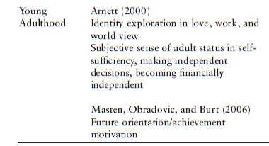
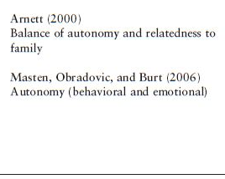
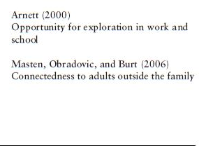
WHAT ARE THE DEVELOPMENTAL TASKS FOR YOUNG ADULTS?
INDIVIDUAL FAMILY SCHOOL/COMMUNITY
See Table 4-1 (pages 78-80)

Slide 21
Studies of risk and protective factors
(1) The effects of risk and protective factors are correlated and cumulative
(2) Risk and protective factors have effects on both specific mental, emotional, and behavioral problems and on multiple problems
(3) Risk and protective factors influence each other over time

Slide 22
Targeting interventions for prevention and promotion
There are usually patterns of factors that are specific to different disorders
We know much more about the pattern of risk factors and prevention than we do about factors that promote specific aspects of well-being

Slide 23
Changing competence
To change competence, some combination of the following needs to be done (example is academic competence):
(1) Change the child’s capabilities (e.g. tutoring)
(2) Change the child’s contexts (e.g., parent education, school reform)
(3) Change child x context “fit” (e.g., change schools)

Slide 24
Childhood depression
Common symptoms: sadness, hopelessness, emptiness, irritability (children may be irritable instead of sad), impaired function, feelings of guilt, worthlessness, loss of pleasure
Annual prevalence
Age 0-5 Very rare
6-10 Low
11-adulthood 5% experience full clinical depression
20% experience a depressive episode
Beginning around age 13, it is twice as common for girls

Slide 25
Middle Childhood Milestones
Family
Time in emotionally responsive interactions with children
Consistent discipline
Parental resources that support/model personal efficacy, adaptive coping, life satisfaction

Slide 26
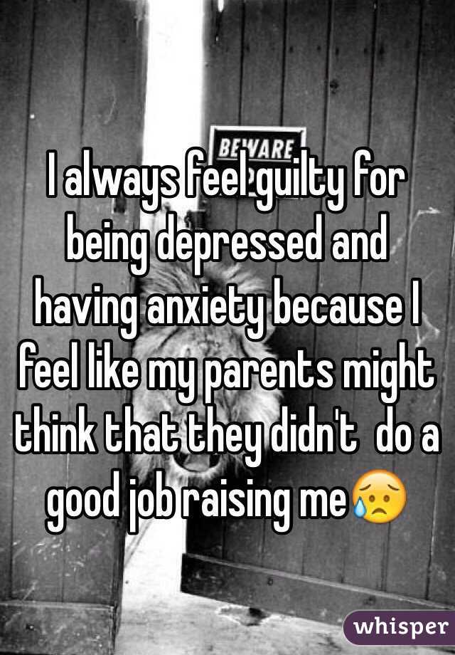
Risks for Depression
Depressed Parents (the double whammy)
Poor parenting (history), high family stress (cause and effect), family conflict
Children may feel responsibility for parent’s hardship and family problems (guilt)
Children may feel anxious about their own feelings of sadness.
Depressogenic Cognitive Style
Rumination, view of the world that lacks optimism, feeling that one is not in control of one’s life

Slide 27
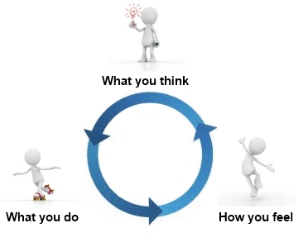
Risks for Depression
What would you do?
Target family processes
Foster parent’s commitment to parenting
Facilitate parental monitoring
Identify causes of family stress
Target child’s understanding and cognitions
Ensure child understands parent is ill and it is
not the child’s fault
Modify cognitive perceptions and processes
Next

Slide 28
anxiety
Common symptoms: (1) FEAR to real or perceived threats, (2) ANXIETY about anticipated future threats, and (3) PANIC ATTACKS
Muscle tension, vigilance and preparation for future threats, cautious and avoidant behaviors
Annual prevalence
Begins early!
Mean age of onset = 7 years old (phobias, separation anxiety)
10 years old (agoraphobia, panic, OCD)

Slide 29
Risks for anxiety
Parents with Anxiety Disorders
Anxious-resistant attachment (inconsistent, insensitive caregiving)
Learning anxious reactions via modeling (social learning theory)
Parenting styles featuring over-control and intrusiveness (authoritarian)
What kind of interventions might you formulate?

Slide 30
Underage drinking
The earlier it starts, the worse the prognosis for dependence in adulthood
Among those age 12-20, about 1/3 recently drank (often binge drinking)
Binge drinking declines markedly after age 25
Implication?

Slide 31
Risks for underage drinking
(1) Positive expectations through modeling
Parents are frequent drinkers
Positive images on TV/movies
(2) Conformity to peer norms
Over-estimation that frequent/binge drinking is normal
Hanging around with peers who drink frequently
What might you to do to intervene?
Limit media exposure, Limit negative role models, Parental monitoring

Slide 32
Generic risk factors
Negative life events
(Lack of) Social support and problem solving coping
Dysfunctional parent-child interactions
Poverty
Family conflict
Poor parental monitoring
Deviant peers
Childhood trauma/maltreatment

Slide 33
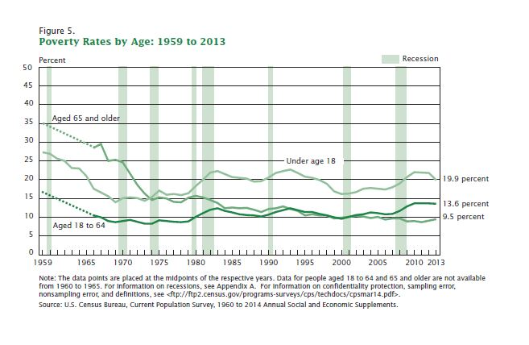
Poverty in the u.s.
19.9% (1 in 5!) of all children (under age 18) live in poverty
16.4% of White children
30.4% of Latino children
38.3% of Black children
Without subsidies, these families do not have the economic means to meet very basic needs
Impairs: Physical health, Cognitive development, and Social competence
2014 Census Tables: https://www.census.gov/hhes/www/cpstables/032014/pov/pov01_100.htm

Slide 34
Poverty paths to mebS
(1) Family resources – affects the quality of the home environment and resources available for cognitive stimulation.
(2) Parental stress – poor/unstable family economy relates to depression, marital conflict, and withdrawn and/or harsh parenting.
(3) Neighborhood/community – poor schools, exposure to gangs/violence/drugs, limited childcare and enrichment activities.

Slide 35
Poverty-focused Interventions
(1) Job training and education for parents.
Finish school; delay childbearing.
(2) Government programs for childcare and food supplementation.
Two generation programs (i.e., parents and children).
(3) Government funding to support high-poverty schools and challenged neighborhoods.

Slide 36
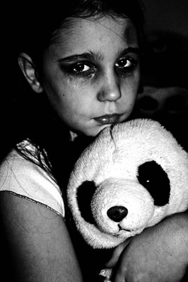
Child maltreatment
An extreme manifestation of parental dysfunction.
Maternal depression is a common aspect.
Prevalence is hard to estimate.
Text: 1.2% of children.
Common element of disorder in psychiatric programs.
Outcomes: depression, SUD, violence, obesity, physical health problems

Slide 37
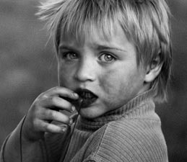
Prevention is critical
This is NOT an experience for which children are likely to be resilient.
Especially problematic if it begins early and is chronic
Social support is protective
Child has a positive relationship with one parent
Child has at least one reciprocal friendship
Effective programs (e.g., nurse home visitation program) emphasize support

Slide 38
Learning objectives
Be able to describe how age, time, and timing are relevant for prevention.
Know the elements of the bioecological model and give examples of its utility for social intervention.
Define and differentiate: competence, developmental cascades, patterning of risks.
Define and discuss risk and projective factors and who they operate over time.
Provide examples of how scientific knowledge of risk factors for common MEBs would translate into intervention approaches.
Discuss examples of “generic risk factors” for MEBs.

