Slide 1
Orientation to the Problems
PSY 372
Developmental Psychology and Social Intervention

Slide 2
Learning Objectives
To understand key concepts in epidemiology and how/why they are important for preventing MEBs
Representative Samples
Prevalence
Co-Morbidity
Incidence
Age of Onset
Risk Factors
Statistics: Interquartile range, odds ratios

Slide 3
Epidemiology is our Friend
The science of public health is concerned with factors that influence the health and illness of populations.
WHO: Which individuals are suffering?
WHAT: For/from which MEBs?
WHEN: At what point(s) in development? For how long? How frequently?
WHERE: In which environments (e.g., geographic areas, cultures)?

Slide 4
What do you think?
(1) What percent of adults have had a diagnosable MEB in the past year?
Texts MAHONEYJ to 22333 to join the session, then text:
A = 3%
B = 10%
C = 20%
D = 33%
E = 50%

Slide 5
What do Epidemiologists Find?
(1) What percent of adults have had a diagnosable MEB in the past year?

Slide 6
What do you think?
(2) What percentage of MEBs are symptomatic by the time they reach puberty?
Texts MAHONEYJ to 22333 to join the session, then text:
A = 3%
B = 10%
C = 20%
D = 33%
E = 50%

Slide 7
What do Epidemiologists Find?
(2) What percentage of MEBs are symptomatic by the time they reach puberty?

Slide 8
What do you think?
(3) What percentage are symptomatic by age 21?
Texts MAHONEYJ to 22333 to join the session, then text:
A = 50%
B = 66%
C = 75%
D = 80%
E = 90%

Slide 9
What do Epidemiologists Find?
(3) What percentage are symptomatic by age 21?

Slide 10
What do you think?
(4) What percentage of children with an MEB are getting treatment for it?
Texts MAHONEYJ to 22333 to join the session, then text:
A = > 10%
B = 10-15%
C = 20-25%
D = 30-35%
E = 40-45%

Slide 11
What do Epidemiologists Find?
(4) What percentage of children with a disagnosable MEB are getting treatment for it?

Slide 12
Key Concepts in Epidemiology
Representative samples of the population of interest.
Note: The less common the MEB, the larger the sample that is needed
Prevalence of MEBs is the total # of cases in the population.
Incidence of MEBs is the total # of new cases in a given period of time
Note: P. 37 is wrong. The glossary is correct.
Co-morbidity means having more than one MEB at the same time.
Co-morbidity is fairly common and predicts severity of MEBs.
Note: mortality rate = # dead; morbidity rate = # diseased, disabled, unhealthy.

Slide 13
Data on MEB is Lacking
The U.S. does not have very good data on MEBs because there are very few national assessments
We rely on studies of smaller populations and international data
What about the NCS-R described in the text?
The NCS was envisioned as a longitudinal, observational study examining the effects of a broad range of environmental and biological factors on children’s health and development by following 100,000 children from the womb to age 21.
http://www.nih.gov/about/director/12122014_statement_ACD.htm

Slide 14
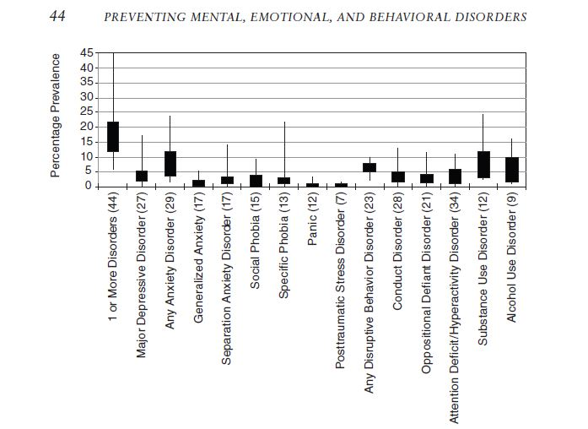
Prevalence: Global estimates for young people
Interquartile Range
The box
Height shows
25th & 75th percentile
The whiskers
Shows the range
of scores
Whisker ends show
the extreme values
The means
17.0 5.2 8.0
6.1
4.5
10.3
Teach Me
Make some
teaching
points about
this graph.
What is noteworthy?
What is missing?

Slide 15
Reflections on MEB prevalence
MEBs are not equally common.
SUD and ANX are most common, followed by DEP and ADHD
Some MEBs ranges are quite variable (e.g., anxiety and substance use) because there are few studies to report. Why?
Also differences in… versions of the DSM, assessment tools, informants, populations and ages
Some MEBs are not shown (e.g., schizophrenia, bipolar disorder).
Some are uncommon and very large samples are needed
Individual differences are not shown (e.g., gender or age).
SUDs is higher for boys
ANX and DEP are higher for girls

Slide 16
Cumulative Prevalence
The proportion of the population receiving at least one diagnosis in a given time frame (e.g., between 9-16).
Text (average of several older studies)
Ages 9-16 = 37-39%
By age 21 = 40-50% (half the population)
Great Smoky Mountain Study (Copeland et al., 2011)
By age 21 = 82.5%
61.1% well-specified disorder
21.4 “not otherwise specified” (NOS*) disorder
Notes:
* “NOS status or symptomatic impairment was met when individuals displayed psychosocial impairment resulting from psychiatric symptoms but did not meet diagnostic criteria. A single symptom might be the basis for an impairment coding related to that symptom's group, but this was uncommon. The average number of DSM-IV symptoms for those displaying symptomatic impairment but not meeting criteria for a formal diagnosis was 4.56 (SD=3.88).

Slide 17
What are the implications?
“…early MEB disorders should be considered as common as a fractured limb. Not inevitable, but not at all unusual.”

Slide 18
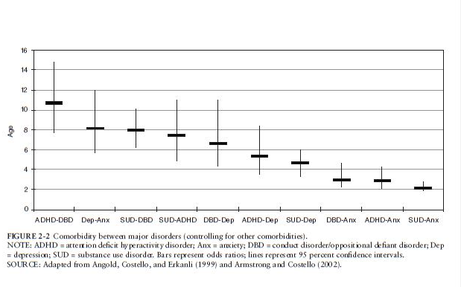
Co-Morbidity
Odd Ratios
An odds ratio (OR) is a
measure of association
between an exposure and
an outcome. The OR
represents the odds that
an outcome will occur
given a particular exposure,
compared to the odds
of the outcome occurring
in the absence of
that exposure.
OR
Illness Clusters
Externalizing
ADHD-DBD-SUD
Internalizing
ANX-DEP-SUD

Slide 19
Incidence
How to determine incidence…
This is longitudinal research. Sample the same population of people more than once.
Begin with those that are free of the disorder, then count the number of people who develop it in the a given time frame.
e.g., 1 month, 6 months, 1 year, 5 years
What do we know? (from the Great Smoky Mountain Study)
3.5% annual rate of new cases for 9-21 year-olds
Recurring problems is the norm (so savings accrue over time)
Half of all lifetime cases start by age 14 (start prevention early)

Slide 20
Reaction Paper for Monday: Historical Rise and Fall of MEBs
We don’t have good data on how MEBs change over history (or why).
Substance use is an exception.
You’re having a dysfunctional family dinner. A rant about how teenagers are drinking, smoking, and using drugs more than they used to ensues. You think this is wrong, but you need data to back up your argument.
The text reports data from the NSDUH taken between 2002-2007 for 8th, 10th, and 12th graders. It shows a clear decline.
But what has happened between 2007 and today? Go to the SAMSHA website, find a good research report, and find out.
Report findings for tobacco, alcohol, and marijuana.

Slide 21
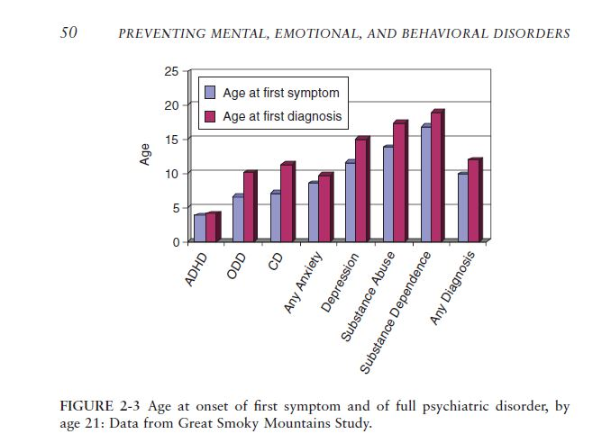
Age of Onset
Mean age at first
symptom/diagnosis.
Gender Differences
Before puberty,
boys have earlier onset.
(ADHD, ODD, CD)
After puberty,
boys have higher SUDs.
girls have higher DEP & ANX.

Slide 22
Risk Factors
A characteristic at the biological, psychological, family, community, or cultural level that precedes and is associated with a higher likelihood of problem outcomes.
Vary across different people, populations, and ages.
Confer at least an additive likelihood of risk.
Are not necessarily causal.
Can be specific or general.
Conduct Disorder* Oppositional Defiant Disorder*
Parental Depression Sexual Abuse
Loss of Close Relationships Poor Parental Supervision
Deviant Peers
SPECIFIC RISKS GENERAL (COMMON) RISKS
Notes:
*Conduct Disorder
Aggression to people and animals
Destruction of property
Deceitfulness or theft
Serious violations of rules
*Oppositional Defiant Disorder
(1) often loses temper (2) often argues with adults (3) often actively defies or refuses to comply with adults' requests or rules (4) often deliberately annoys people (5) often blames others for his or her mistakes or misbehavior (6) is often touchy or easily annoyed by others (7) is often angry and resentful (8) is often spiteful or vindictive

Slide 23
Learning Objectives
To understand key concepts in epidemiology and how/why they are important for preventing MEBs
Representative Samples
Prevalence
Co-Morbidity
Incidence
Age of Onset
Risk Factors
Statistics: Interquartile range, odds ratios

