Slide 1
Background to the Course
PSY 372
Developmental Psychology and Social Intervention

Slide 2
Learning Objectives
Know the prevalence of MEBs and discuss the seeming paradox between the high prevalence and stigma.
Understand goals and limitations of the 1994 IOM report.
Know and be able to describe (with an example) each of the nine (9) foundational ideas for the current NRC-IOM report (your text).
Discuss pros and cons to preventing MEBs for young people.
Understand how the critical thinking and active learning activities relate to particular foundational ideas.

Slide 3
Rate how uncomfortable would you feel sharing the following information with your peers. 5-point scale (1 = not at all uncomfortable ; 5 = very uncomfortable)
My mom broke her ankle and has to wear a cast right now.
I have a chronic ear infection and take medication everyday to stay symptom free.
My mom has major depression and goes to counseling right now.
I have bipolar disorder take medication everyday to stay symptom free.

Slide 4
Mental, Emotional, and Behavioral Disorders (MEBs) are Very Common
Right now, 14-20% (1 in 5) young people (to age 25) has a diagnosable MEB.
40% have had a MEB by age 16.
≈ 80% will have had a MEB by age 21 (Copeland).
Most of these young people will not get the help they need. Why not?

Slide 6
Filmed May 2013 at TEDxKids@Ambleside Kevin Breel: Confessions of a depressed comic
http://www.ted.com/talks/kevin_breel_confessions_of_a_depressed_comic
10:56

Slide 7
MEBs are Very Expensive
$288 billion annually is a conservative 2015 estimate
The 2014 U.S. Department of Education budget = $67.3 billion

Slide 8
Background to this Course
Goals of the 1994 IOM Report
Clarify the distinction between prevention and treatment
Prevention means addressing the risks prior to the onset of illness
Addressing “general risks” is critical (e.g., maternal depression, poverty, family disruption)
Intervention includes mental health promotion

Slide 9
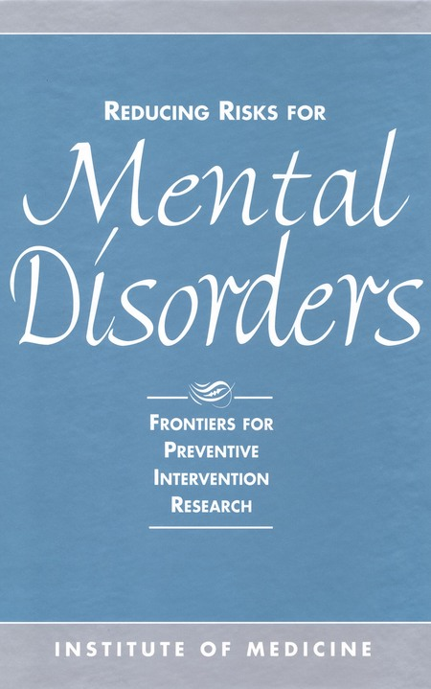
Background to this Course
Prevention is not Treatment
Treatment is retroactive, waiting for an illness to develop before action is taken.
Prevention is proactive and focused on maintaining and promoting current and future well-being.

Slide 10
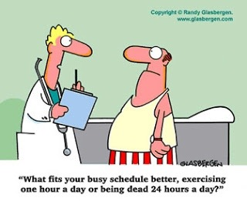

Slide 11
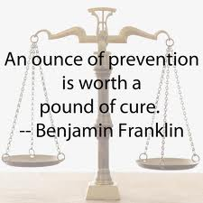
In-Class Activity
Treatment vs. Prevention

Slide 12
Background to this Course
Limitations of the 1994 IOM Report
Lack of clear developmental framework
Based on the medical model
Over-emphasis on genetic/biological causes
Acontextual and simplistic

Slide 13
The Field has Advanced
Extrapolate to 2015
≈ 60 studies
Published RCTs of preventive interventions with young people between
1980-2007. [Does not include treatment of promotion studies]

Slide 14
Why Should We Prevent MEBs?
Directions:
Identify as many pros (reasons we should) and cons (reasons we should not – risks, concerns, or cautions) prevent MEBs.
Discuss your list with a neighbor or two and come up with a combined list to present to the class.
Notes:
Pros
Government should provide for the welfare of the people
Public health has shown this can work! Social sciences just lags behind.
Humane to prevent suffering
Reduction of stigma
Economically logical - Cost effective – benefits individual and society.
Test theories of development
Cons
Labeling and stigma of those targeted
Defective genes
Individuals have the right to refuse treatment, why not prevention (passive consent)
Iatrogenic effects (e.g., may symptoms worse, create new problems, suicide)
Parenting is often involved – parenting is a private matter?

Slide 15
9 Foundational Ideas
1. Childhood contexts are critical
2. A developmental approach is necessary
3. There are common trajectories across multiple MEBs
4. A range of coordinated services are needed
5. Mental and physical health are inseparable
6. Translational research is critical
7. There are gaps in the knowledge base
8. We need a parity of research on prevention and treatment
9. We need you!

Slide 16
1. Foundational Ideas
Childhood contexts are critical
Most MEBs have their root causes in childhood
Early environments can have lasting influence
Prenatal, family, and school

Slide 17
2. Foundational Ideas
A developmental perspective is necessary
We cannot intervene effectively unless the pathways of MEBs are understood
Early development is a “window of opportunity”
But, many other “windows” exist (e.g., transition to adolescence) and later contexts also matter.

Slide 18
3. Foundational Ideas
There are common trajectories across multiple MEBs
One intervention can affect multiple disorders
We need to study common risk and protective factors, shared pathways to disorder
Most research still targets single problems

Slide 19
4. Foundational Ideas
A range of coordinated services are needed to provide services and share knowledge
25% of MEB costs for children are incurred in the school and justice systems
25% of pediatric care visits are about child behavior problems
Information on “what works” may not be obvious to people working with these children

Slide 20
“Pop Assignment”: Using Prevention Resources
Long-term learning objective: Develop your knowledge and skills to research, implement, and disseminate interventions in diverse community contexts.
Short-term learning objective: Become acquainted with three common resources used by prevention scientists.

Slide 21
Directions
The Elizabethtown Area School District (EASD) is concerned about the high prevalence of MEBs among local high school students. They are asking you to help identify and discuss effective prevention programs the school district should consider implementing.
Choose a MEB to focus your search.
Consult each of the following 3 prevention resources for a few minutes and pick a prevention program that you think EASD should consider. Be prepared to say how and why you chose the program.

Slide 22
The IES “What Works” Clearinghouse
http://ies.ed.gov/ncee/wwc/
The goal of the WWC is to be a resource for informed education decision making. To reach this goal, the WWC identifies studies that provide credible and reliable evidence of the effectiveness of a given practice, program, or policy (referred to as “interventions”), and disseminates summary information and free reports on the WWC website. With over 700 publications available and more than 10,500 reviewed studies in the online searchable database, the WWC aims to inform researchers, educators, and policymakers as they work toward improving education for students.

Slide 23
SAMHSA’s Prevention of Substance Abuse and Mental Illness
SAMHSA = Substance Abuse and Mental Health Services Adminstration
http://www.samhsa.gov/prevention
Promoting mental health and preventing mental and/or substance use disorders are fundamental to SAMHSA’s mission to reduce the impact of behavioral health conditions in America’s communities.
Hint: check out the “NREPP” database: http://nrepp.samhsa.gov/

Slide 24
SPR’s “Prevention Science”
http://www.springer.com/public+health/journal/11121
Prevention sciences encompassing etiology, epidemiology and intervention are represented through peer-reviewed original research articles on a variety of health and social problems, including but not limited to substance abuse, mental health, HIV/AIDS, violence, accidents, teenage pregnancy, suicide, delinquency, STD's, obesity, diet/nutrition, exercise, and chronic illness. The journal also publishes literature reviews, theoretical articles, meta-analyses, systematic reviews, and papers concerning new developments in methodology.
Hint: use the “search within this journal” box

Slide 25
Some Federal Agencies that Award Funding to Prevention Programs (states, counties, and local communities)
Substance Abuse and Mental Health Services Admiration (SAMSHA)
Department of Health and Human Services
Office of Safe and Drug Free Schools
Department of Education
Office of Juvenile Justice and Delinquency Prevention
Department of Justice
Prevention Sidebar

Slide 26
Some Federal Agencies that Research/Evaluate Federal Prevention Programs
National Institutes of Health (includes NIMH)
Department of Health and Human Services
Institute of Educational Sciences
Department of Education
National Institute of Justice
Department of Justice
Prevention Sidebar

Slide 27
5. Foundational Ideas
Mental and physical health are inseparable
Young people are physically healthy group, but…
Most DALYs (disability-adjusted life years) for 15-24 year-olds are due directly to MEBs, substance use, suicide, homicide, or car accidents that are strongly connected to MEBs.
Most DALYs can be targeted for prevention
24% pediatric care visits are for behavior problems
Physical health problems can cause MEBs and MEBs can cause physical health problems
Examples?
Notes:
DALYs are disability-adjusted life years, an aggregate number of years lost to premature mortality and years lost to disability, which has been used to monitor progress in public health for 291 diseases and injuries. (NIHM, 2015)
One DALY can be thought of as one lost year of "healthy" life. The sum of these DALYs across the population, or the burden of disease, can be thought of as a measurement of the gap between current health status and an ideal health situation where the entire population lives to an advanced age, free of disease and disability. (WHO, 2015)
WHO 2015: http://www.who.int/healthinfo/global_burden_disease/metrics_daly/en/

Slide 28
6. Foundational Ideas
Translational research is critical
The process of turning observations in the laboratory, clinic and community into interventions that improve the health of individuals and the public. (DHHS, 2015)
How can we adopt/adapt effective interventions to work in different communities?
How can we identify and evaluate local efforts that work?
Answer: Research-Community partnerships

Slide 29
7. Foundational Ideas
There are gaps in the knowledge base
The true prevalence of different MEBs in young people is unknown
The risks for many MEBs are poorly understood
The prevention workforce to study MEBs is inadequate
The systems needed to effectively prevent MEBs may not be developed or well-coordinated

Slide 30
8. Foundational Ideas
We Need a Parity of Research on Prevention and Treatment
Screening populations and high-risk communities
Implementation, including ethnic minority communities
Dissemination
Neuroscience and epigenetic linkages
Use of technology
Assessment of iatrogenic effects
Mental health promotion

Slide 31
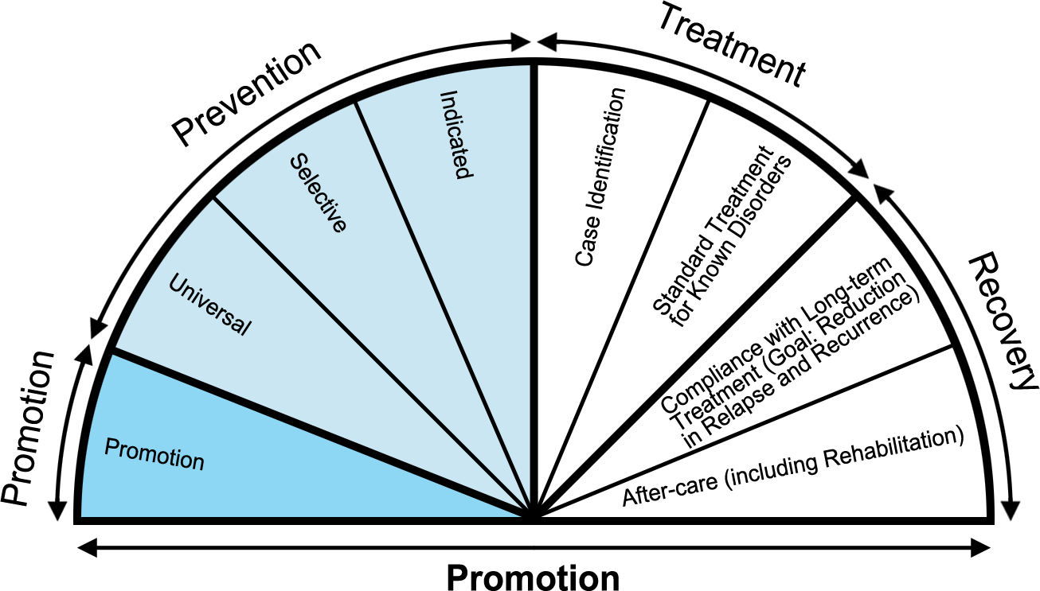
Mental Health Promotion
“…there is no bright line separating promotion from prevention or prevention from treatment. [They] lie on a continuum, with each aspect of the continuum warranting attention.” (p. 31)

Slide 32
9. Foundational Ideas
We need you!
We need training programs to prepare the workforce to fill the gaps.
Retrain professionals
Establish training centers
Establish graduate programs
Start early (undergraduates)

Slide 33
Learning Objectives
Know the commonality of MEBs and discuss the seeming paradox between prevalence and stigma.
Understand goals and limitations of the 1994 IOM report.
Know and be able to describe (with an example) the 9 foundational ideas for the current report (your text).
Discuss pros and cons to preventing MEBs for young people.
Understand how the critical thinking and active learning activities relate to particular foundational ideas.

